Slide 1

EDA: Airline Passenger Satisfaction
Authors: Tony Dong (UIN: 815118831)
Erick Rodriguez (UIN:)
Jamie Parra (UIN:815029081)
Date: November 30, 2023

Slide 2
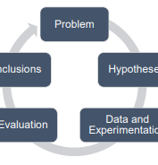
Introduction
The EDA course project is the culmination of the data analysis skills put into practice through the use of canva and dashboard. The goals are to address an issue, identify stakeholders involved, and provide action that could impact or lead to a business opportunity.
Practical skills of EDA include extracting useful information, visualizing patterns, provide informative analysis, and impacting decisions. It is an iterative process.
Data analysis on airline passengers regarding satisfaction and additional sentiment using variety of datasets.

Slide 3

Project Objectives
Research a compelling issue.
Identify the stakeholders involved.
Find a relevant dataset.
Produce a canva
Prepare the dataset for analysis such as data cleaning.
Provide descriptive and visual analysis
Produce a dashboard

Slide 4

Project Objectives
Objective 1: Main goal is provide the stakeholders, airline passengers, a customer friendly infographic.
Objective 2: Analyzes satisfaction factors and what contributes to a satisfied customer.
Objective 3: Discover sentiment in regards how customers view airlines.

Slide 5
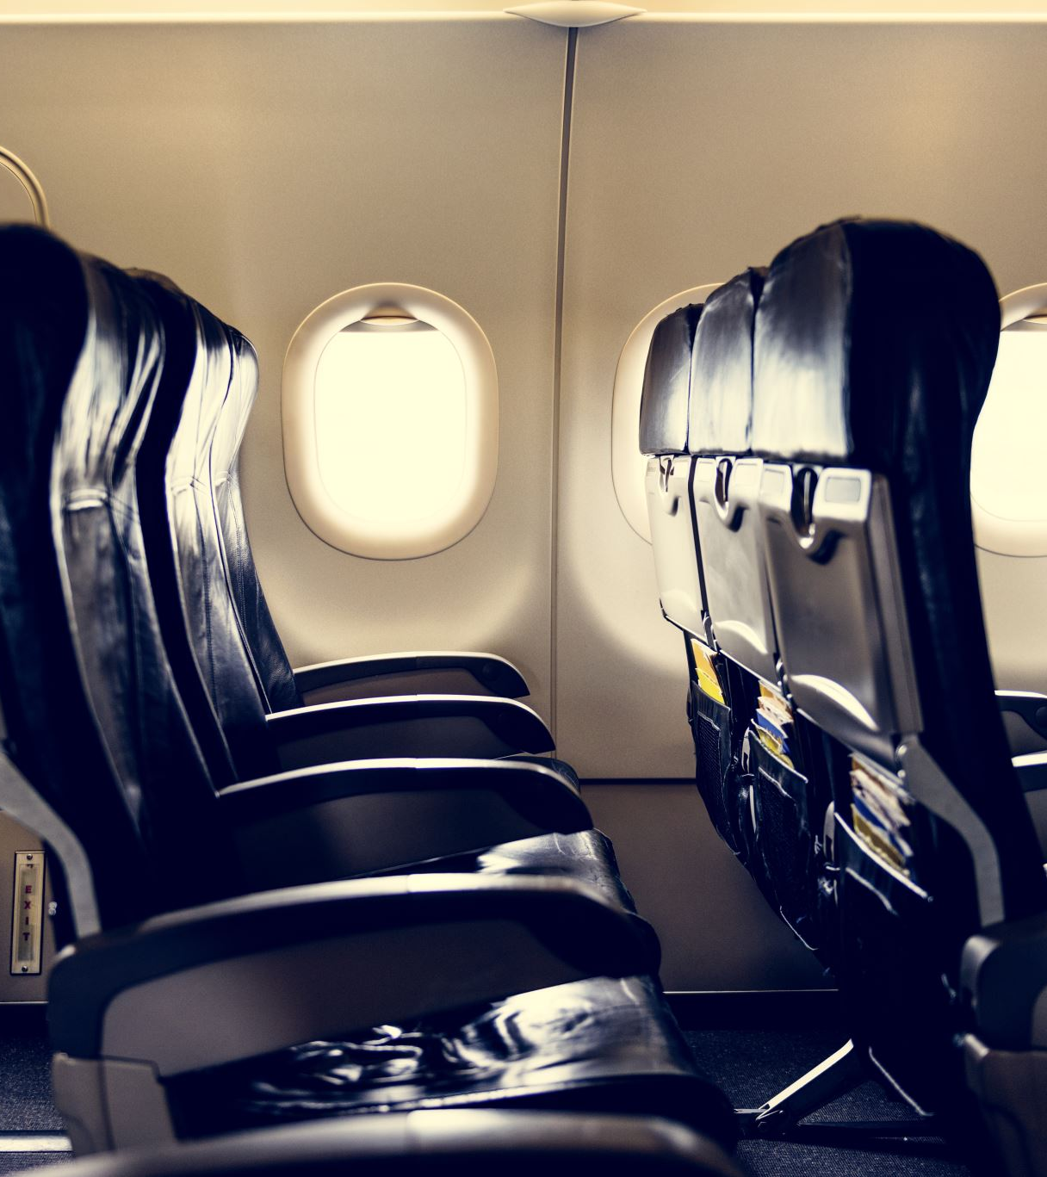
Dataset Selection
https://www.kaggle.com/datasets/teejmahal20/airline-passenger-satisfaction
The dataset contains airline passengers survey responses for satisfaction and factors leading to satisfaction.
Provide stakeholder information such as age, gender, and customer loyalty.
https://www.kaggle.com/datasets/juhibhojani/airline-reviews
The dataset involved contain airline reviews based on airlinequality.com.
Text based analysis will extract keywords that highlight passengers’ sentiments for airlines.
Provides similar satisfaction ratings but through variable ‘Recommended’

Slide 6
Data Dictionary
Variable Name | Definition (meaning) | Domain
Gender | Gender of passenger | Binary: Female, Male
Customer Type | The loyalty of the customer | Binary: Loyal customer, disloyal customer
Age | Actual age of passenger | Integer: ex. 52
Type of Travel | Purpose of the flight of passenger | Binary: Personal Travel, Business Travel
Class | Travel class of the passengers | Ordinal i think: Business, Eco, Eco Plus
Flight Distance | Flight distance of journey | Integer: ex. 160
Inflight wifi services | Satisfaction level of inflight wifi services | Ordinal: [0: Not Applicable; 1, 2, 3, 4, 5]
Departure/Arrival time convenient | Satisfaction level of Departure/Arrival time convenient | Ordinal: [0: Not Applicable; 1, 2, 3, 4, 5]
Ease of Online Booking | Satisfaction level of online booking | Ordinal: [0: Not Applicable; 1, 2, 3, 4, 5]

Slide 7
Data Dictionary cont.
Online boarding | Satisfaction level of online boarding | Ordinal: [0: Not Applicable; 1, 2, 3, 4, 5]
Seat comfort | Satisfaction level of Seat comfort | Ordinal: [0: Not Applicable; 1, 2, 3, 4, 5]
Inflight entertainment | Satisfaction level of inflight entertainment | Ordinal: [0: Not Applicable; 1, 2, 3, 4, 5]
On-board service | Satisfaction level of On-board service | Ordinal: [0: Not Applicable; 1, 2, 3, 4, 5]
Leg room service | Satisfaction level of Leg room service | Ordinal: [0: Not Applicable; 1, 2, 3, 4, 5]
Baggage handling | Satisfaction level of baggage handling | Ordinal: [0: Not Applicable; 1, 2, 3, 4, 5]
Check-in service | Satisfaction level of Check-in service | Ordinal: [0: Not Applicable; 1, 2, 3, 4, 5]
Inflight service | Satisfaction level of inflight service | Ordinal: [0: Not Applicable; 1, 2, 3, 4, 5]

Slide 8
Data dictionary cont.
Cleanliness | Satisfaction level of Cleanliness | Ordinal: [0: Not Applicable; 1, 2, 3, 4, 5]
Departure Delay in Minutes | Minutes delayed when departure | Integer: ex.50
Arrival Delay in Minutes | Minutes delayed when arrival | Integer: ex.40
satisfaction | Airline satisfaction level | Binary: satisfied, neutral or dissatisfied
Gate location | Satisfaction level of Gate location | Ordinal: [0: Not Applicable; 1, 2, 3, 4, 5]
Food and drink | Satisfaction level of Food and drink | Ordinal: [0: Not Applicable; 1, 2, 3, 4, 5]

Slide 9
Data Dictionary
Variable name | Definition (meaning) | Domain
Airline Name | Name of airline | String: ex. AB Aviation
Overall Rating | Overall rating | Ordinal: [n: N/A: 1,2,3,4,5,6,7,8,9]
Review_Title | Review title | String: ex. ‘Aircalin customer review’
Review Date | Date in | String: ex. 23rd February 2009
Verified | Verification of the review | Binary: True/False
Review | Customer review message | String: ex. ‘Great service fair price very attentive crew..’
Aircraft | Name of the aircraft | String: ex.TU304
Type Of Traveller | Reason for travel | Categorical: Solo Leisure, Business, Couple Leisure, Family Leisure

Slide 10
Data Dictionary cont.
Seat Type | Airline class | Ordinal: [Economy Class, Premium Economy Business Class, First Class]
Route | Source to destination route | String: ex. DUB to CDG
Date Flown | Month and day flight flown | String: ex. Dec-17
Seat Comfort | Rating for seat comfort | Ordinal: [0,1,2,3,4,5]
Cabin Staff Service | Rating for cabin staff service | Ordinal: [0,1,2,3,4,5]
Food & Beverages | Rating for food & beverage | Ordinal: [0,1,2,3,4,5]
Ground Service | Rating for ground service | Ordinal: [0,1,2,3,4,5]
Inflight Entertainment | Rating for inflight entertainment | Ordinal: [0,1,2,3,4,5]

Slide 11
Data Dictionary cont.
Wifi & Connectivity | Rating for wifi & connectivity | Ordinal: [0,1,2,3,4,5]
Value For Money | Rating for value for money | Ordinal: [0,1,2,3,4,5]
Recommended | Recommend or not review | Binary: no, yes

Slide 12
Exploratory Data Analysis (EDA) Process
Data cleaning: There are no missing values in the 1st dataset although data variables were renamed for easier recognition, such as ‘satisfaction’ to ‘Satisfaction’. For the 2nd dataset, stemming or lemminization for word clouds. There are missing values also which are ignored.
Data exploration: Finding correlation with the variable ‘satisfaction’ and other variables, calculating
Data visualization: Visualizations addressing the ‘satisfaction’ variable.

Slide 13
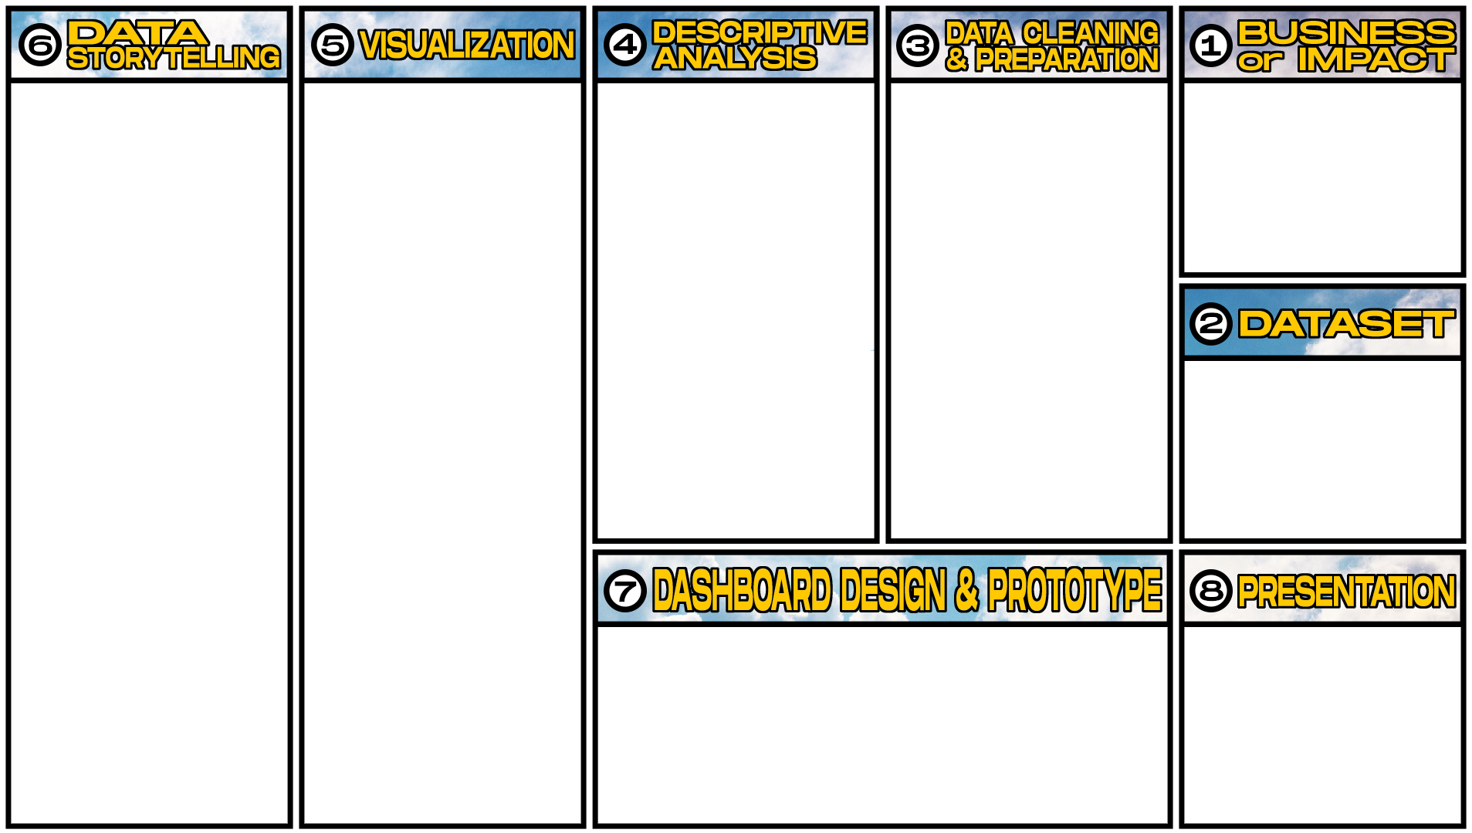







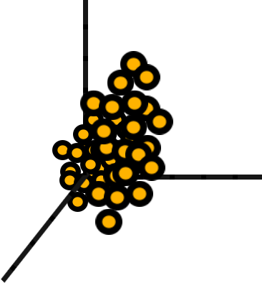


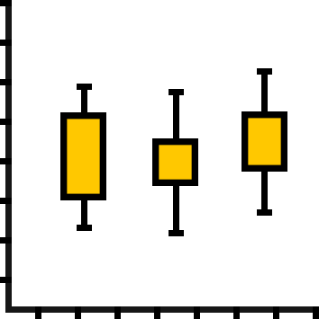

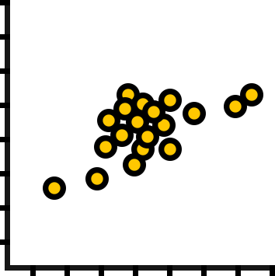
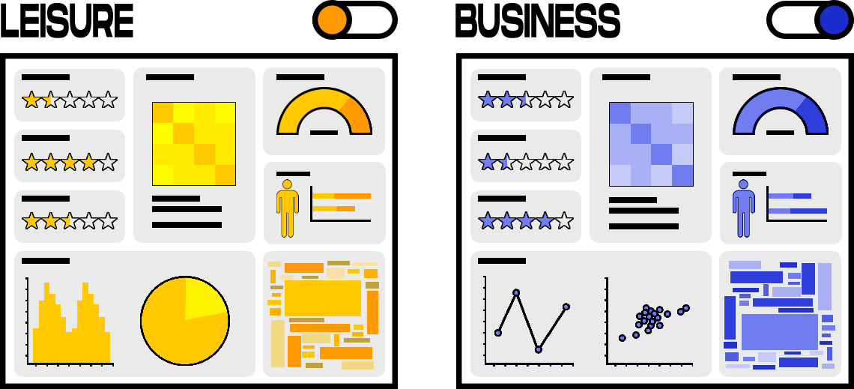
Heatmap
Histogram
Pie Chart
Boxplot
Line Graph
Scatter Plot
Word Cloud
Network Graph
3D Scatterplot
Overall Customer Satisfaction
Flight Punctuality
Flight Crew Performance
Pricing
Customer Demographic
Rout Analysis
Flight Amenities:
WiFi
Food
TVs
Comfort per Class
Cleanliness
Luggage Handling
Mount .csv files into one or two larger ones.
Most datasets share similar variables
Written Reviews:
Remove Stop Words
Lemmatization or Stemming
Airline Industry
User Satisfaction
Impact:
Airline Preferences for Business
Airline Preference for Leisure
Punctuality
Business Amenities:
WiFi
Luggage
Flexible Itinerary
Check-In Process
Airline Satisfaction Dataset
Passenger Reviews Dataset
Airline Reviews
Pricing (Seasonality)
Booking Process
Flight Crew Service
Leisure Amenities:
TV
Food
Comfort
Cleanliness

Slide 14

Dashboard Design and Presentation
Overview
Multiple sliders act as filters for the dataset categorical variables
Design choice background:
Average satisfaction factors to be visualized as ratings in form of stars
Emphasis
Concept Development
This infographic will provide airline passengers levels of satisfaction when choosing airlines while indirectly promoting the better airlines.

Slide 15

Datasets
https://www.kaggle.com/datasets/juhibhojani/airline-reviews
https://www.kaggle.com/datasets/teejmahal20/airline-passenger-satisfaction
https://www.kaggle.com/datasets/iamsouravbanerjee/airline-dataset
https://www.kaggle.com/datasets/welkin10/airline-sentiment
https://www.kaggle.com/datasets/sherrytp/airline-delay-analysis

Slide 16
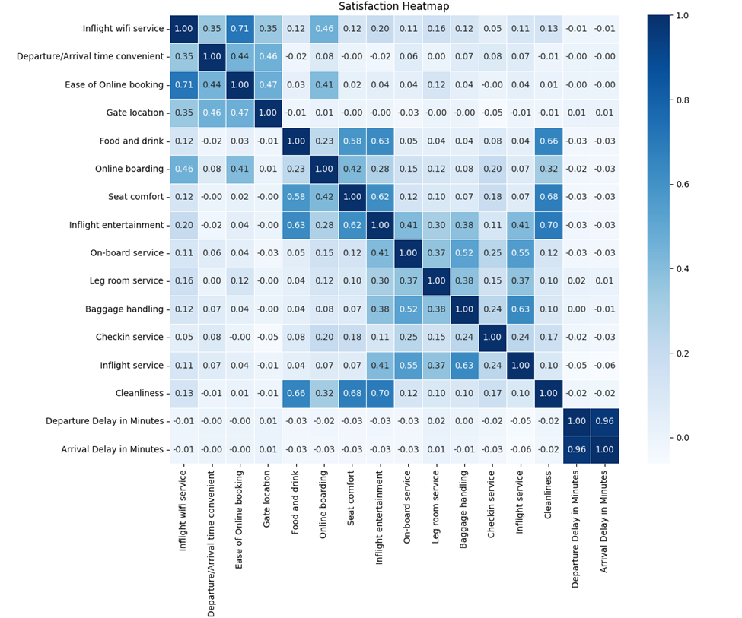
Heatmap test.csv general factors satsifaction

Slide 17
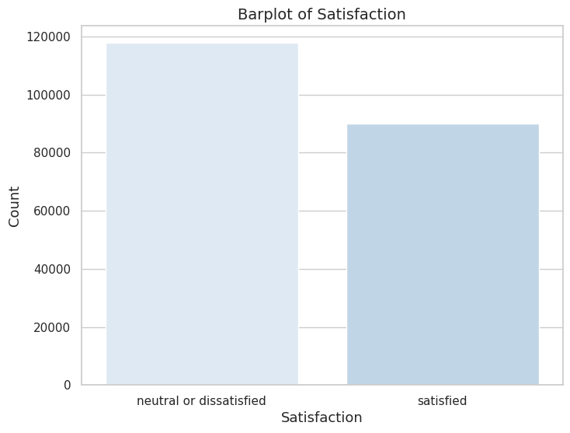
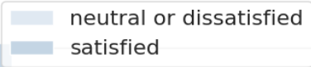
Total Airline Flying Sentiment

Slide 18
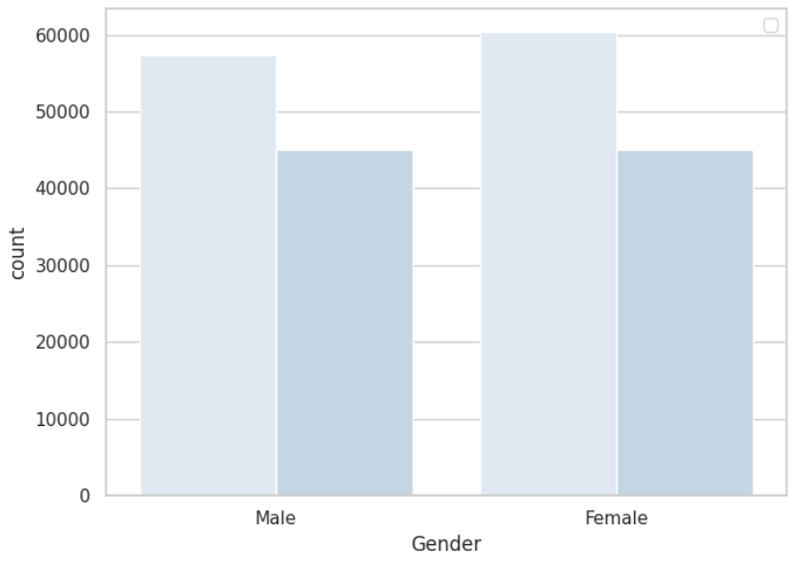
Flying Sentiment by Gender

Slide 19
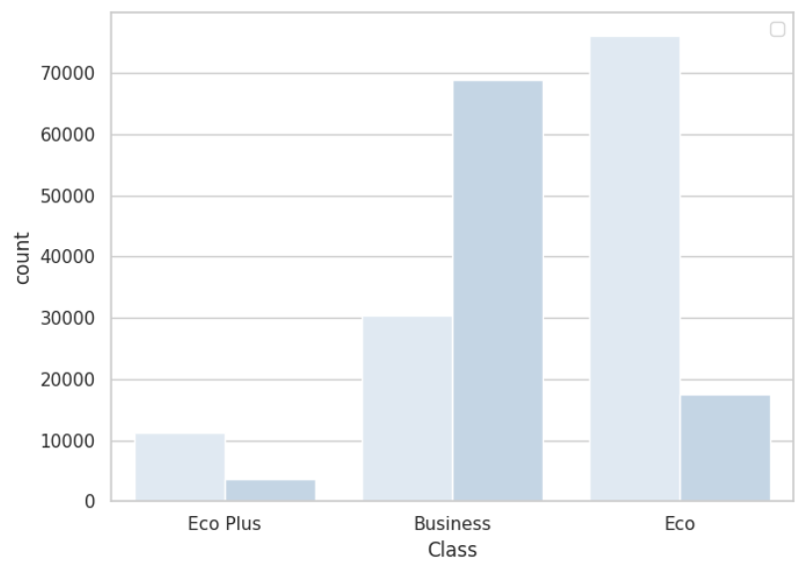
Flight Class Sentiment

Slide 20
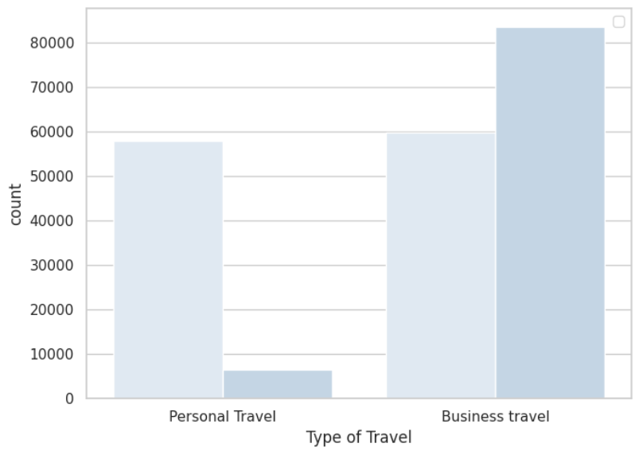
Travel Purpose Sentiment

Slide 21
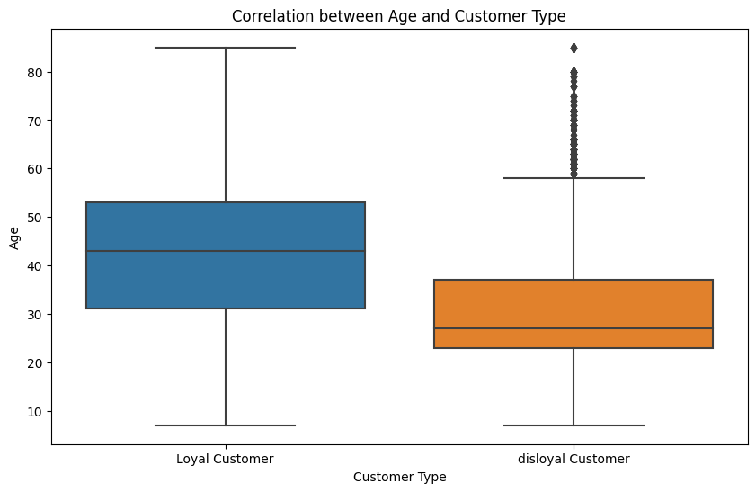
Age by Customer Type

Slide 22
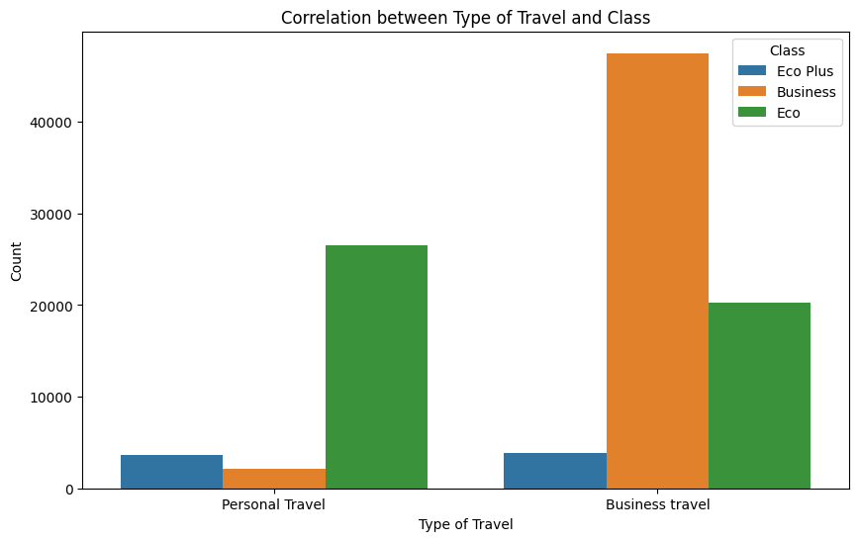
Travel Purpose Class

Slide 23
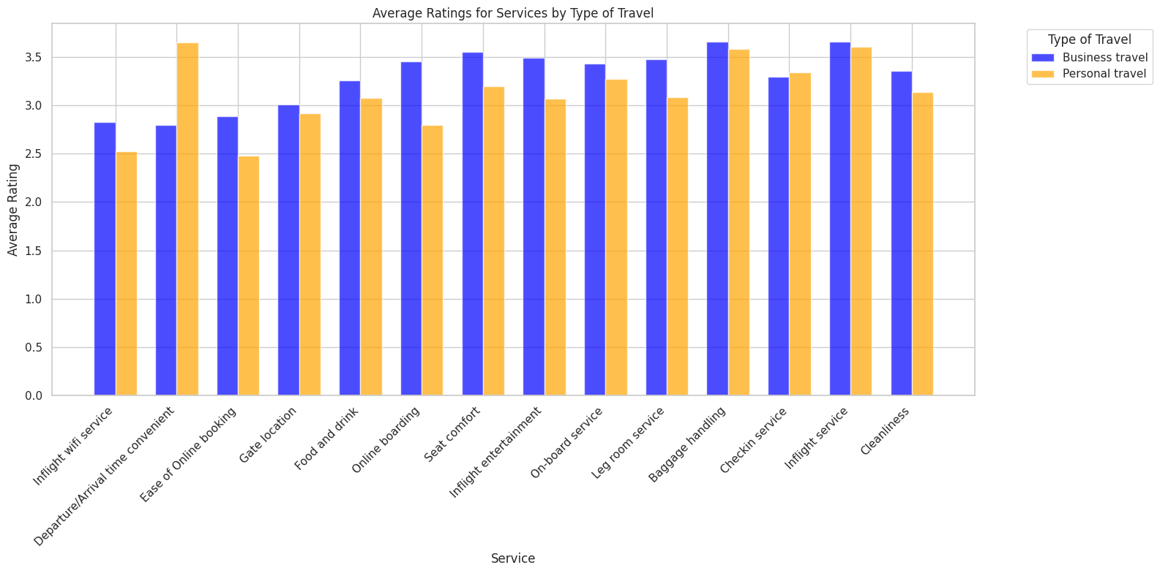

Slide 24
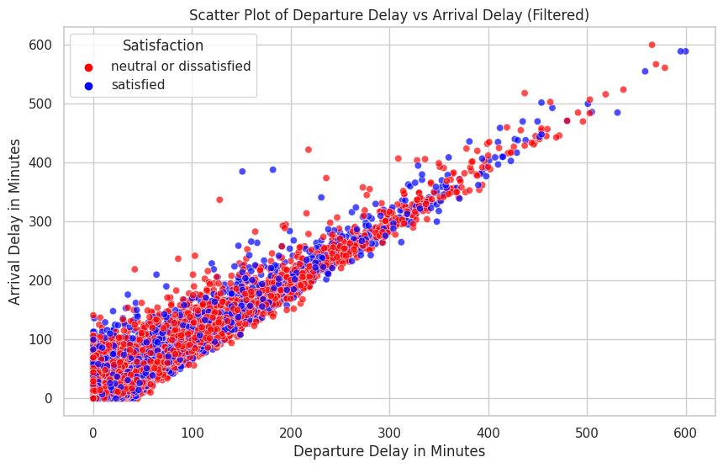
Arrival vs Delay Time Sentiment

Slide 25
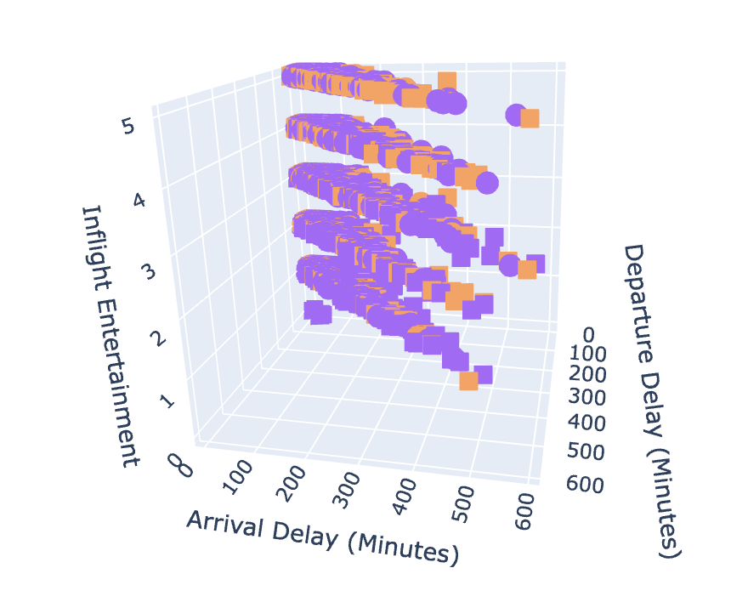
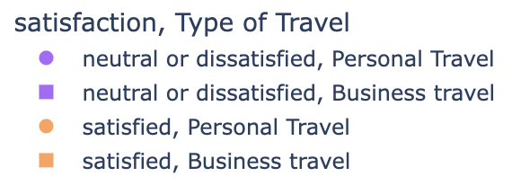
Arrival Delay vs Departure Delay vs Entertainment Sentiment

Slide 26
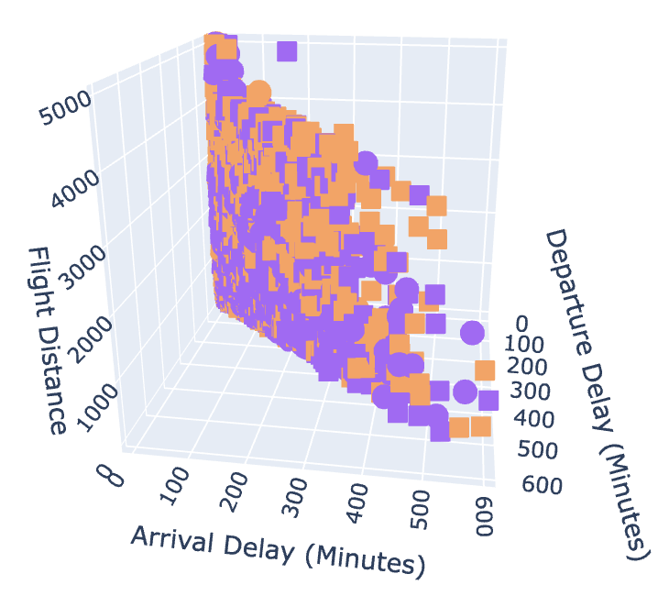
Arrival Delay vs Departure Delay vs Flight Distance Sentiment

Slide 27
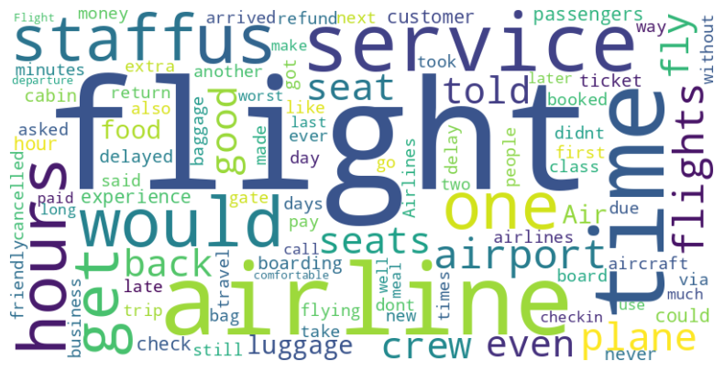
Reviews Words Cloud Frequency

Slide 28
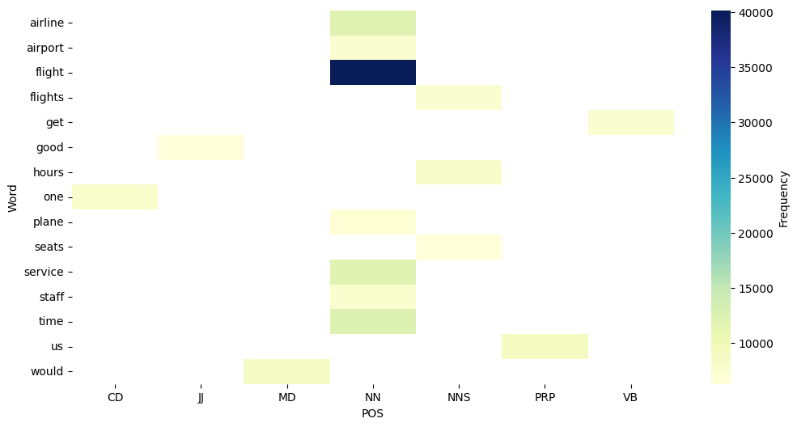
Reviews Words Cloud Frequency

Slide 29
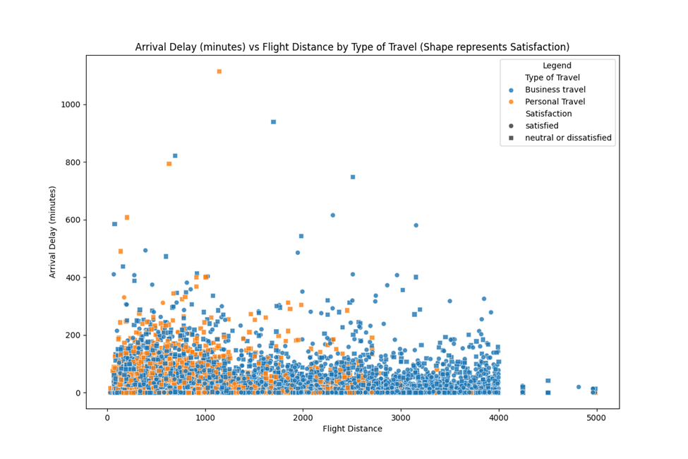
Bubble chart: Arrival Delay, distance, type of travel, satifsaciton

Slide 30

Bubble chart: Dep Delay, distance, type of travel, satifsaciton

Slide 31
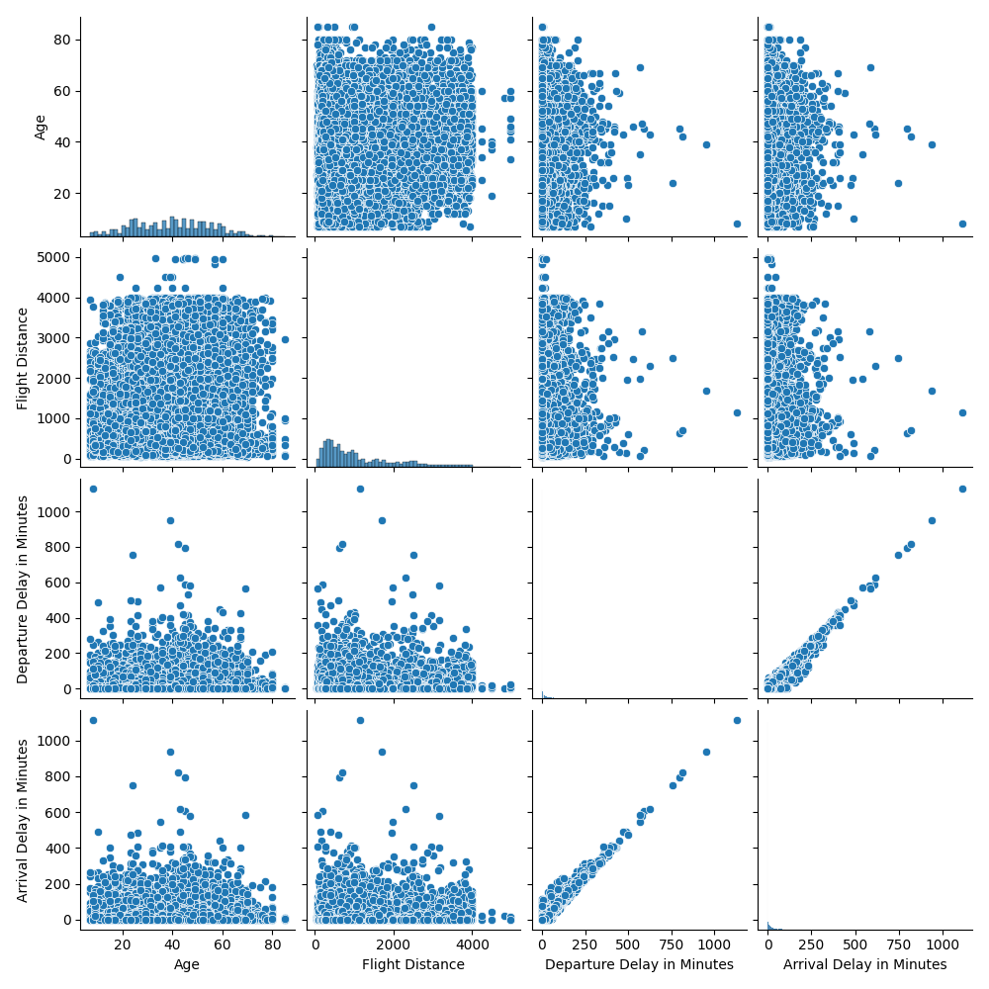
Scattermatrix: age, distance, depart, arrival

Slide 32
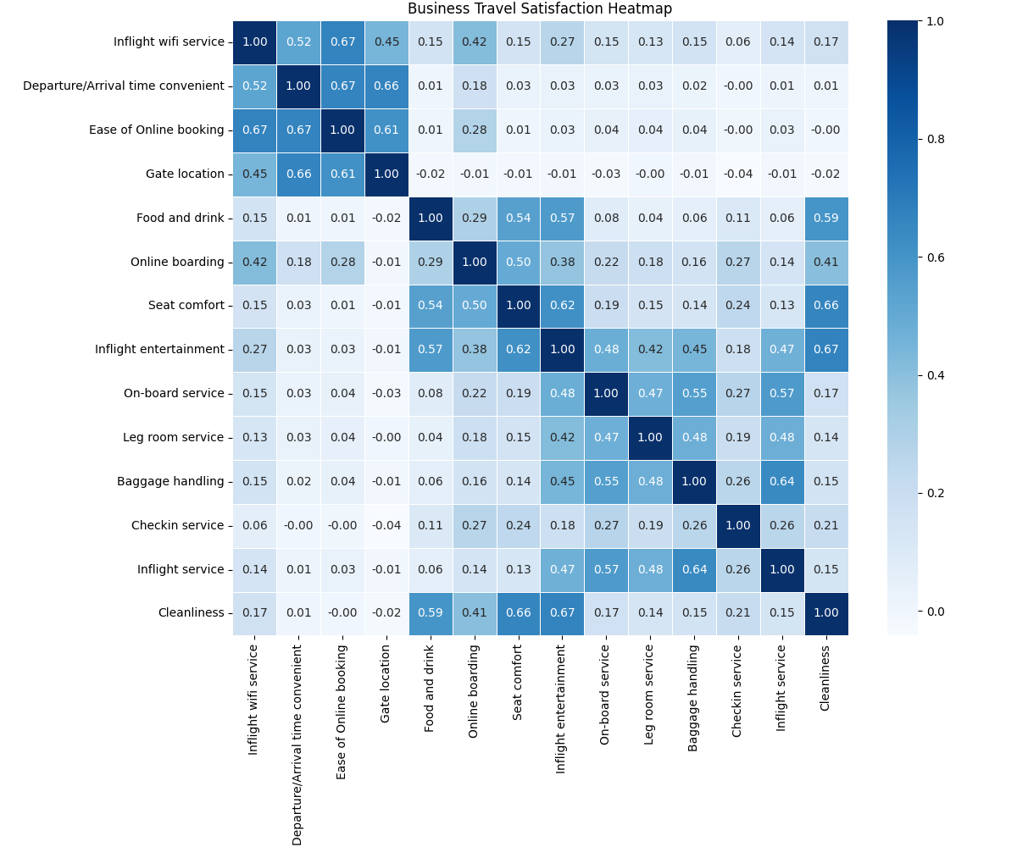
Heatmap Business

Slide 33
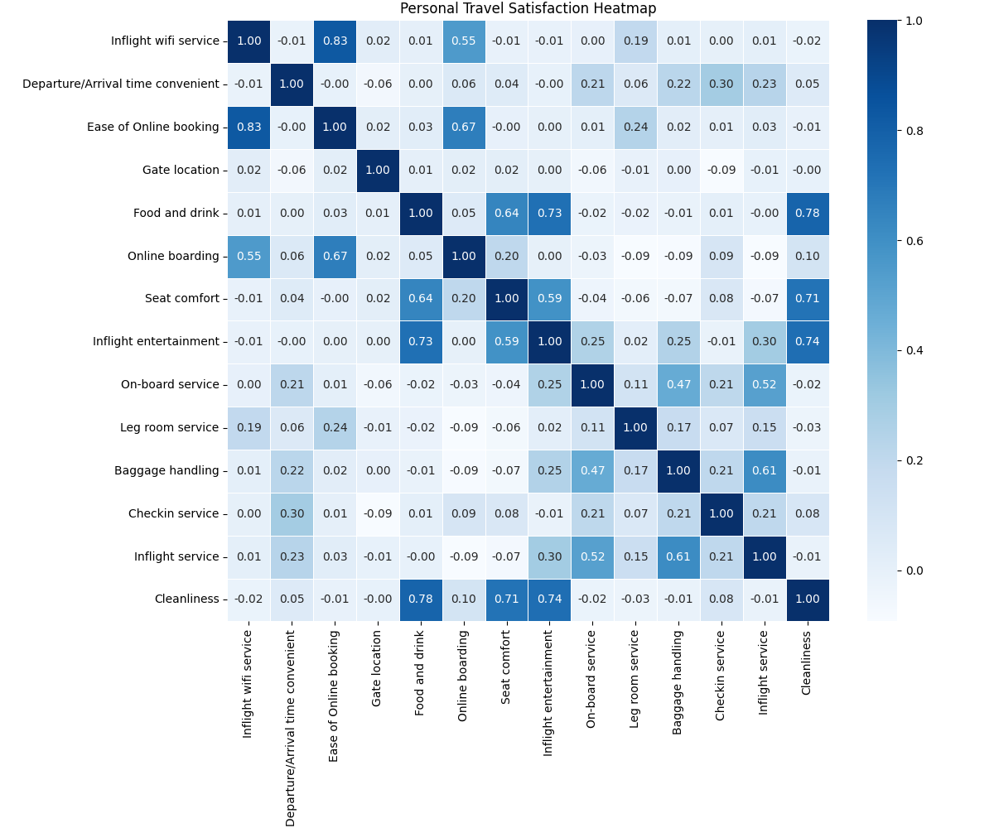
Heatmap Personal

Slide 34
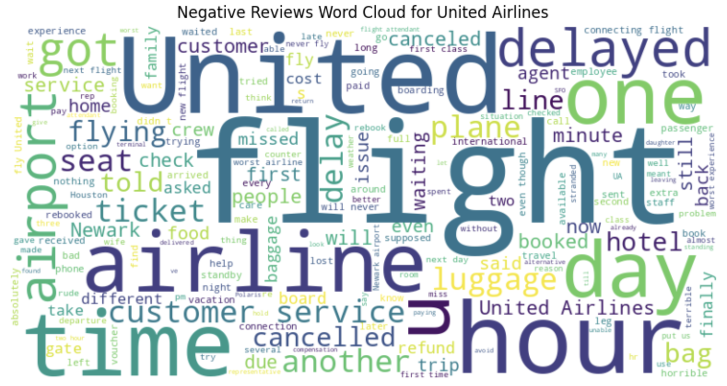
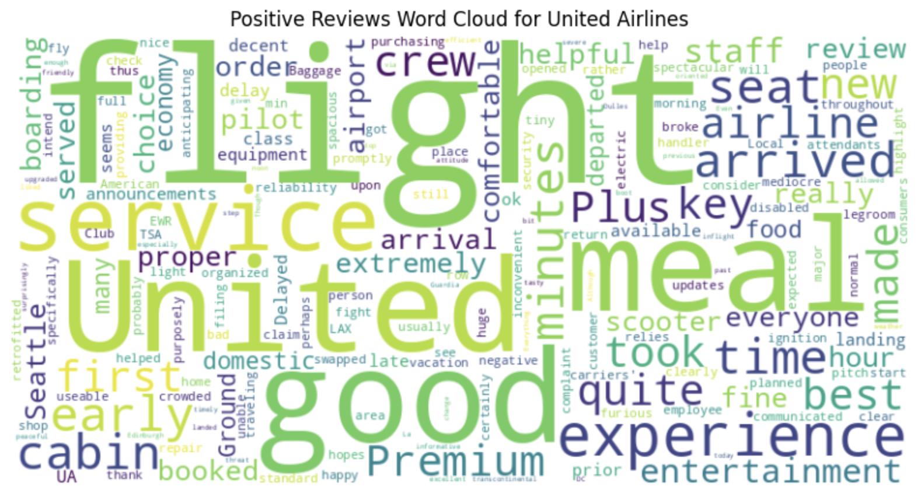
United Airlines

Slide 35
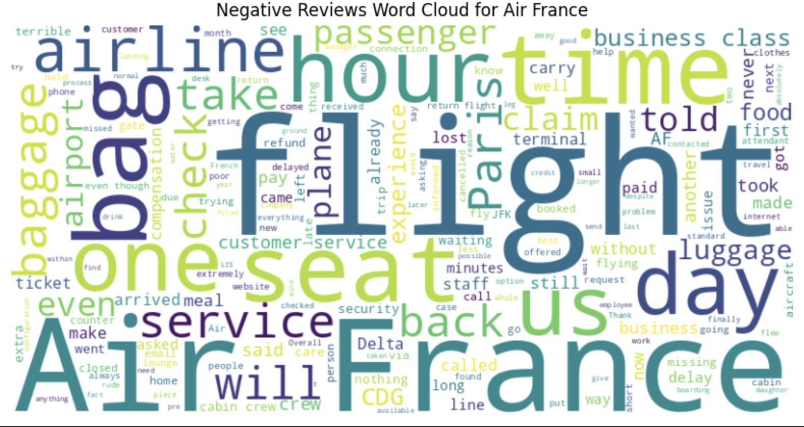
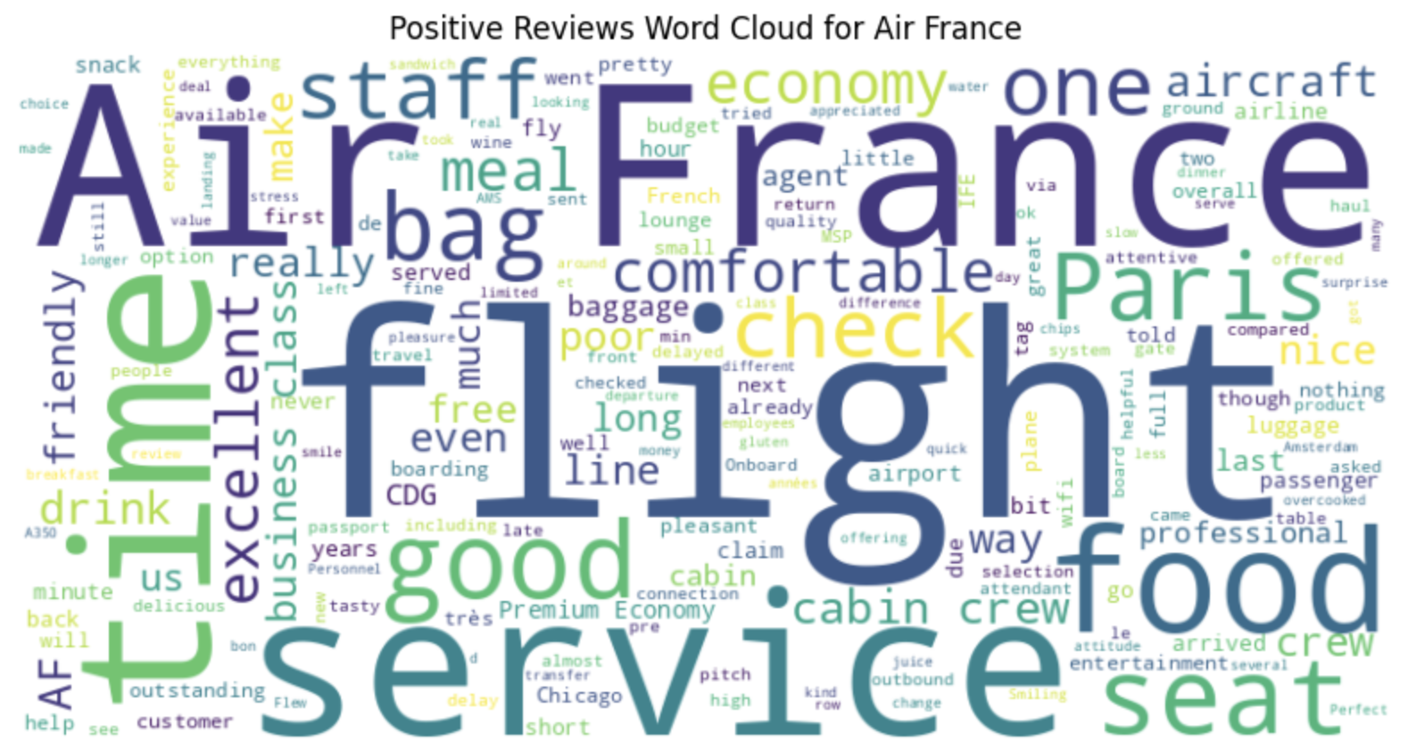
Air France

Slide 36
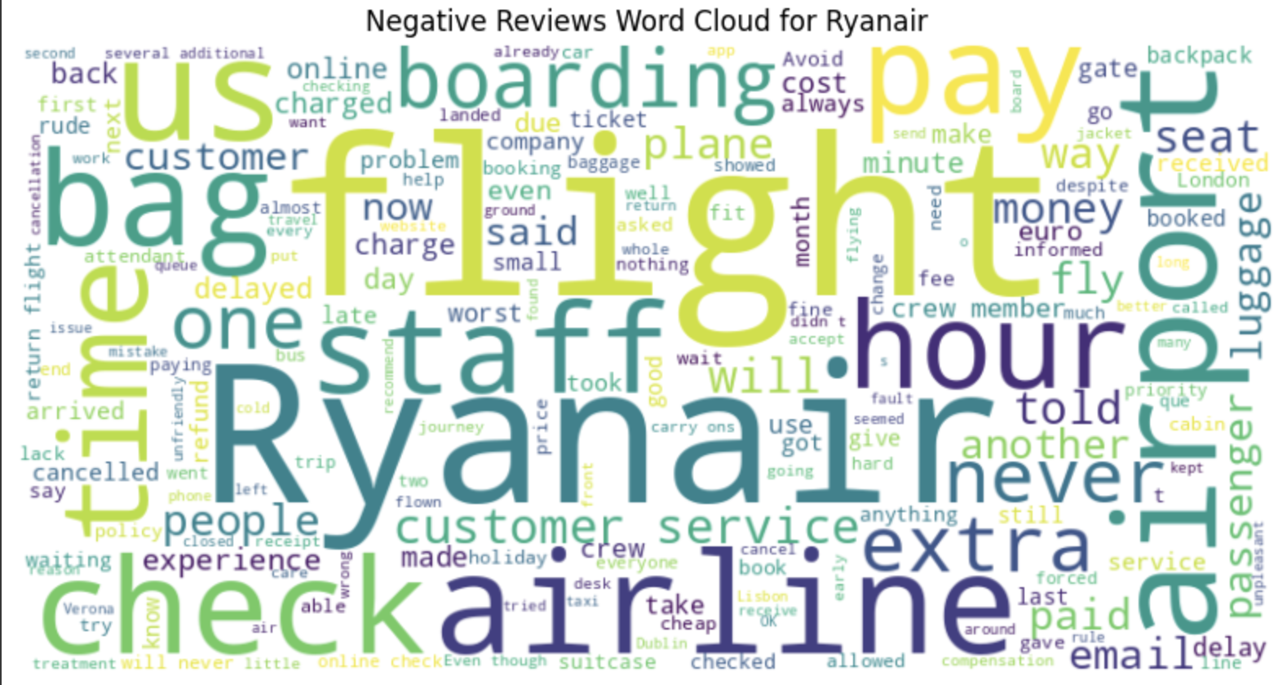
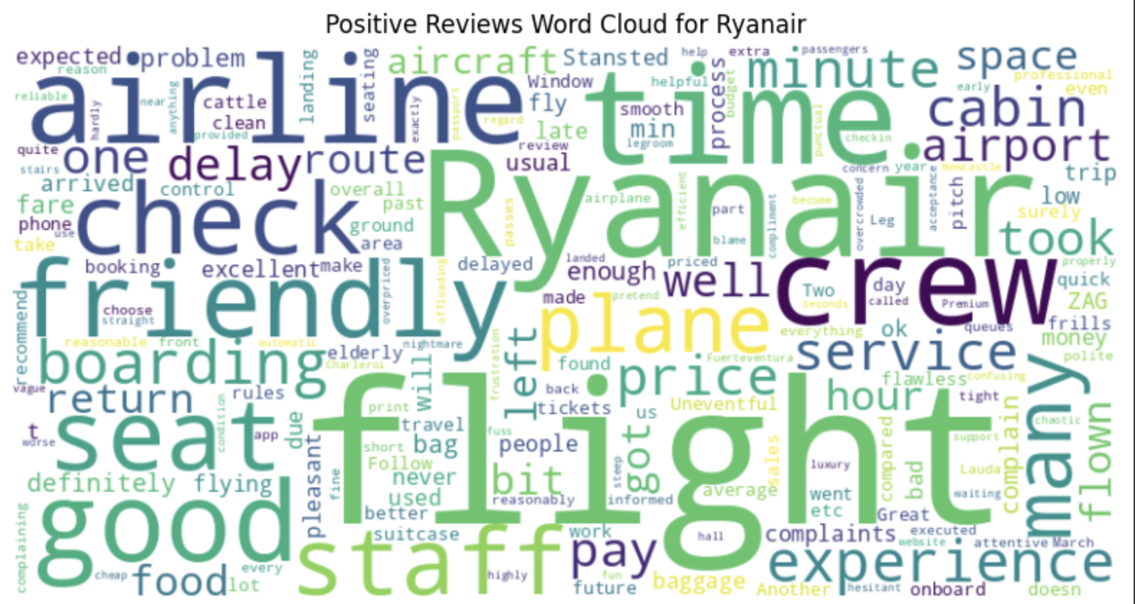
Ryanair

Slide 37
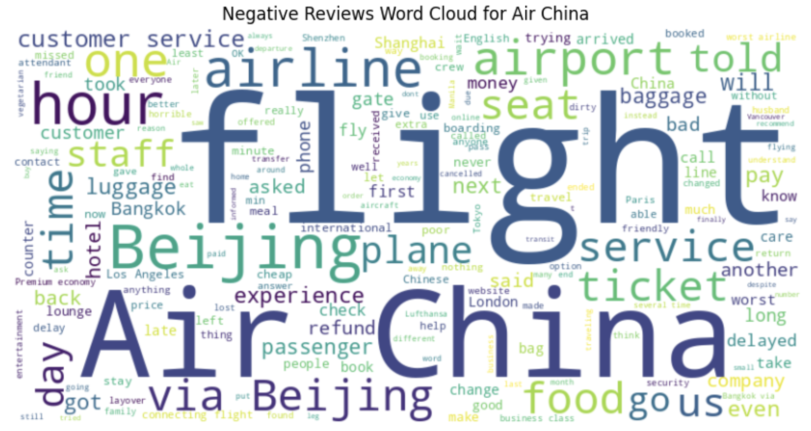
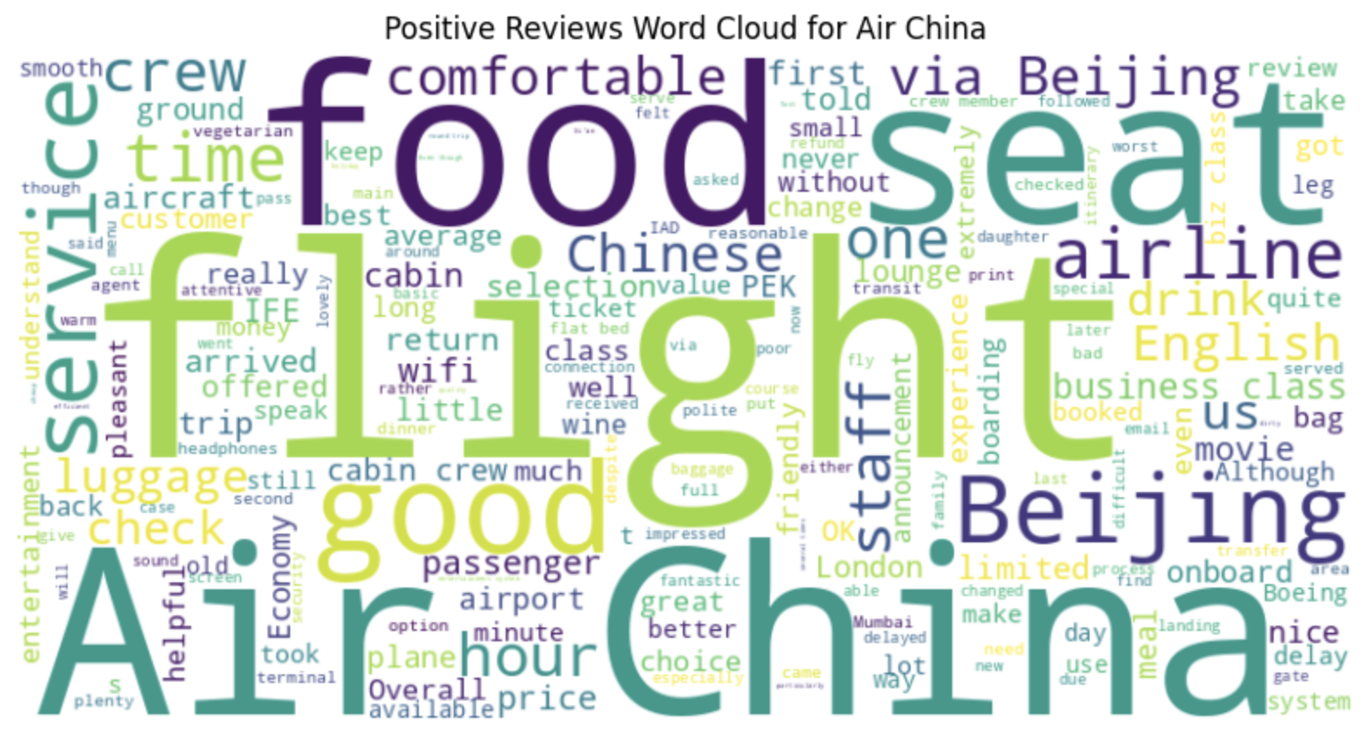
Air China

Slide 38
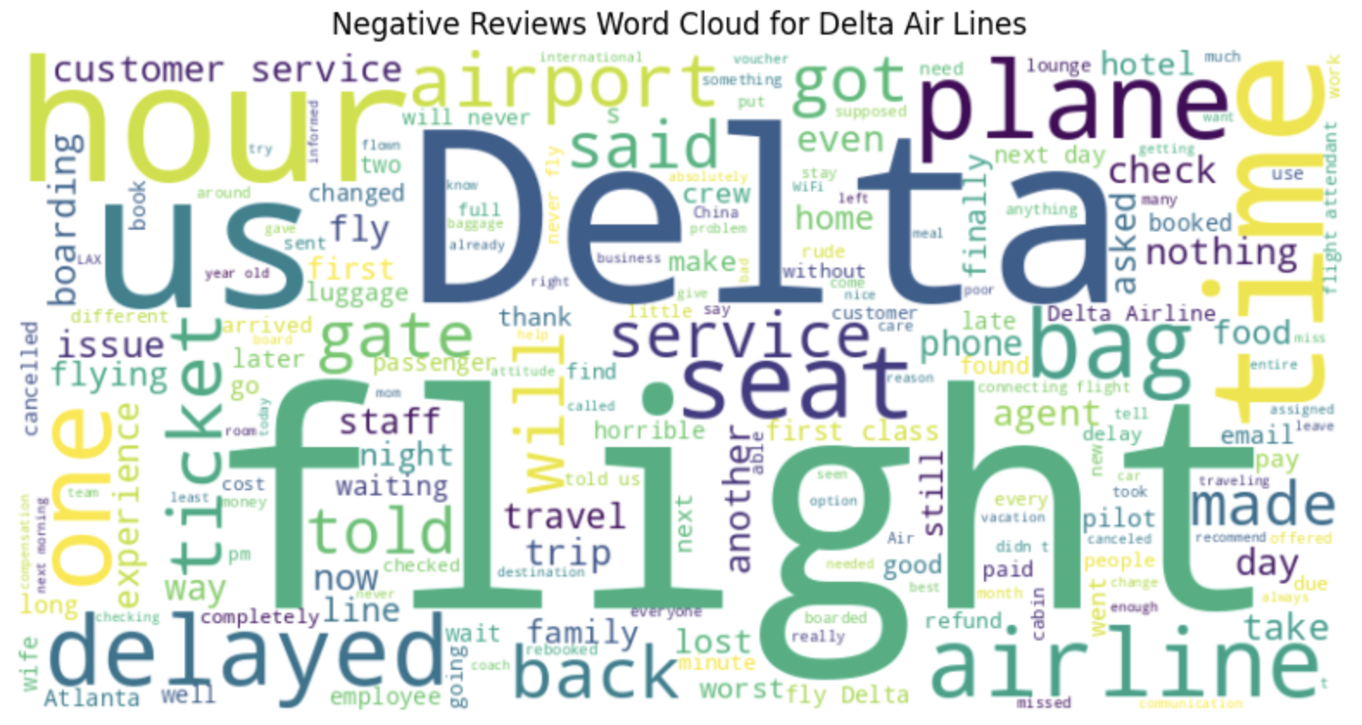
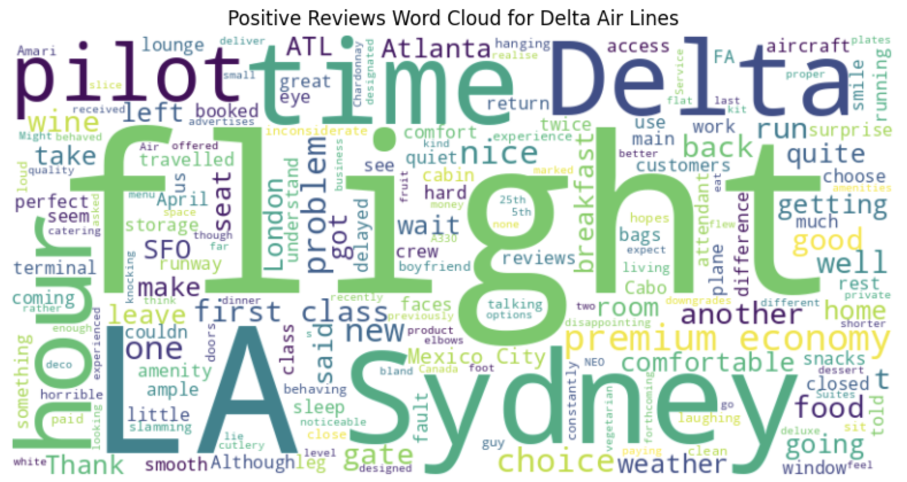
Delta Airlines

Slide 39
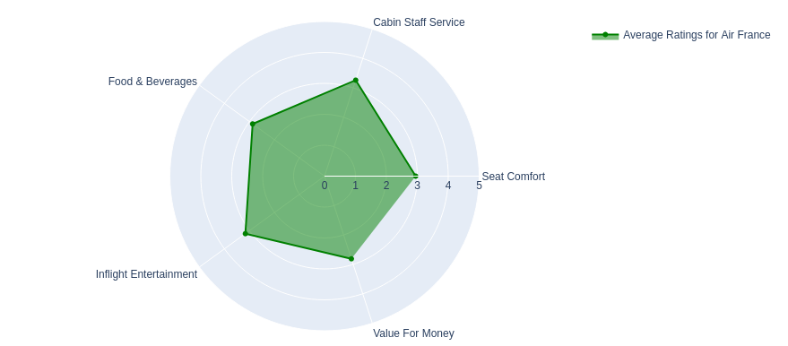
Air France Ratings

Slide 40
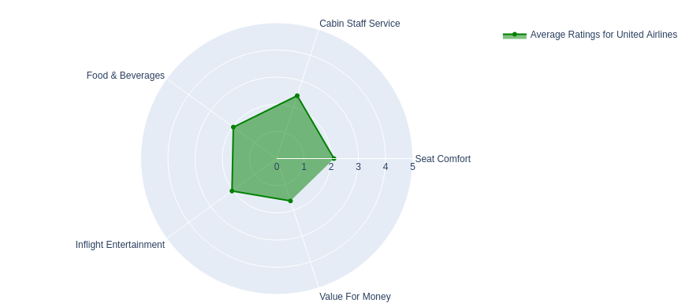
United Airlines Ratings

Slide 41
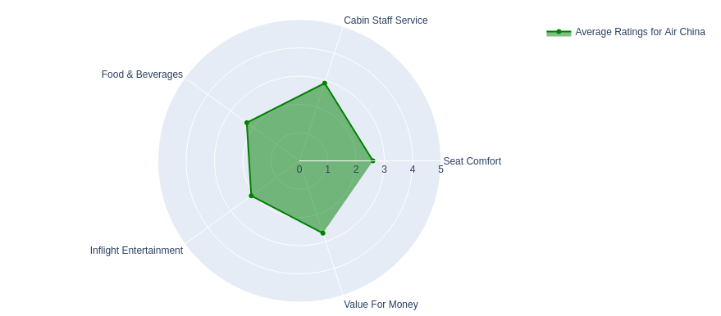
Air China Ratings

Slide 42
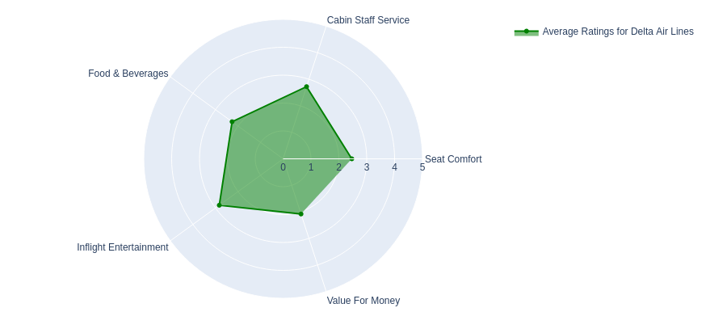
Delta Airlines Ratings

Slide 43
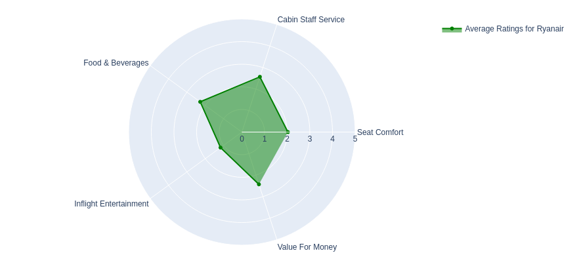
Ryanair Ratings

Slide 44
Challenges, Lessons Learned and Future Works
Challenges
Finding the correct visuals for the dashboard and filtering methods. Avoiding cluttering visuals was key early on.
Lack of time variable that match with relevant data for time series in canva.
Lesson Learned
Additional datasets were required to have a better understanding of the subject
Seeking additional tools to visualize the dashboard.
Future Works
View the issue by addressing other stakeholders of airline industry such as airline executives and sales instead of airline passengers.

